Slide 1
Chapter 04: Graph Theory
Discrete Maths
HND CSD
BCAS Campus, Kalmunai

Slide 2
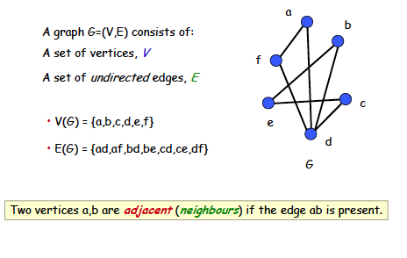
Simple graph

Slide 3
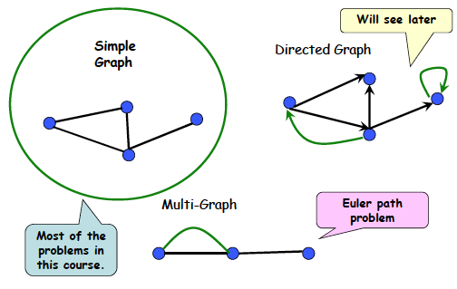
Types of graph

Slide 4
Definitions
At most one edge between a pair of nodes
Multiple edges between some pair of nodes
Simple graphs vs. multi-graphs
Undirected vs. directed graphs (digraphs)
Each edge between a pair (u, v) of nodes is directed, and represents an ordered pair

Slide 5
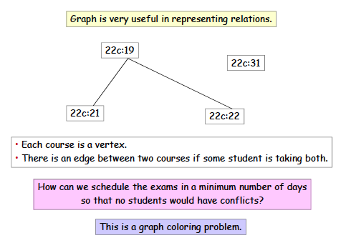
Application: Exam scheduling
Why?

Slide 6
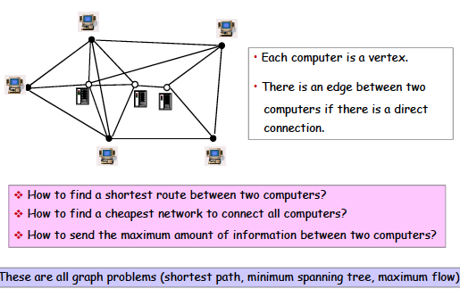
Problems in a computer network

Slide 7
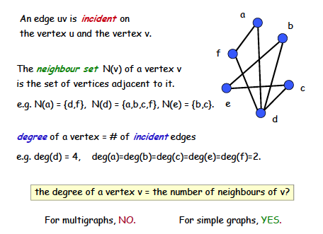
Vertex degree

Slide 8
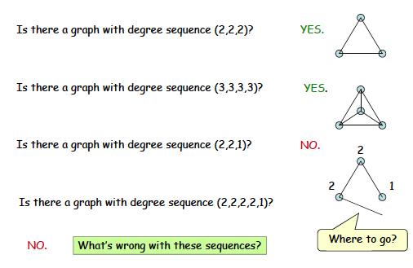
Degree sequence

Slide 9
A theorem
THEOREM. An undirected graph has even number
of vertices of odd degree.

Slide 10
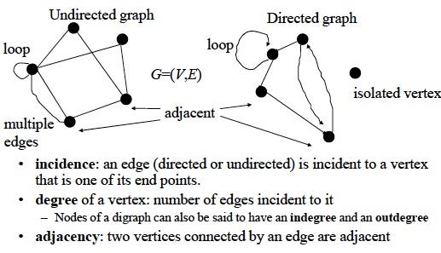
Review of basic definitions

Slide 11
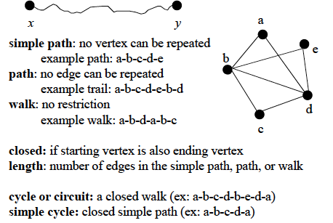
Review of basic definitions

Slide 12
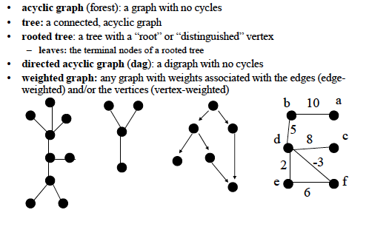
Types of graphs
A cycle of a graph is a subset of its edge set that forms a path such that the
first node of the path corresponds to the last.

Slide 13
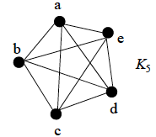
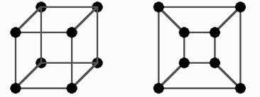
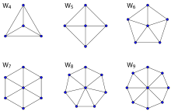
Types of graphs
The n-cube graph
n=3
Complete graph:
All vertices are adjacent
Wheel graph

Slide 14
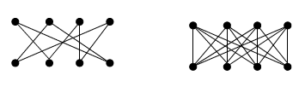
Types of graphs
Bipartite graph
A simple graph is called bipartite if its vertex set V can be
partitioned into two disjoint subsets V1 and V2, such that
every edge in the graph connects a vertex in V1 to a vertex
in V2.
Can always be colored using two colors.

Slide 15
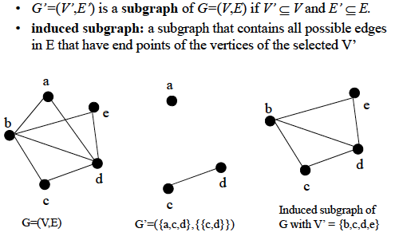
Subgraphs

Slide 16
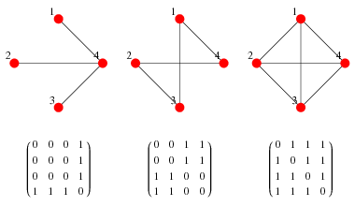
Computer representation of graphs
ADJACENCY MATRIX
(taken from Wolfram Mathworld)

Slide 17
Computer representation of graphs
ADJACENCY LIST
1
Vertex | Adjacent to
1 2 3 4 | 3, 4 3, 4 1, 2 1, 2
2
4
3
Can be represented as a linked list

Slide 18
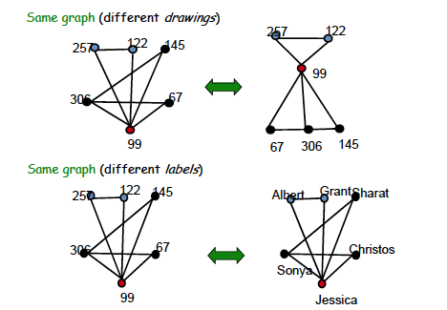
Graph isomorphism
Taken from MIT 6.042J/18.062J

Slide 19
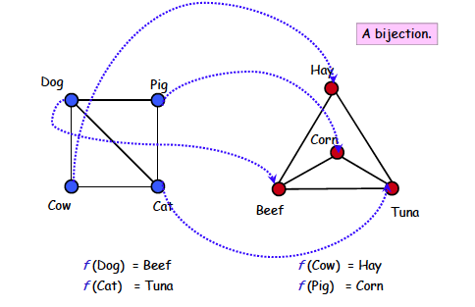
Graph isomorphism
Taken from MIT 6.042J/18.062J

Slide 20
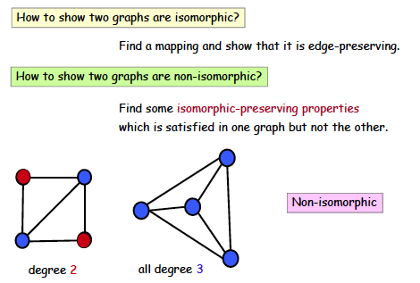
Graph isomorphism
Taken from MIT 6.042J/18.062J

Slide 21
Connectivity
An undirected graph is connected if there is a path between
every pair of distinct vertices of the graph.
A connected component is the maximal connected subgraph
of the given graph.

Slide 22
Connectivity issues
Erdös number in academic collaboration graph
Erdös number = n means the person collaborated
with someone whose Erdös number is (n-1)
Kevin Bacon number in Hollywood graph
Actor Kevin Bacon once remarked that he worked with
everybody in Hollywood, or someone who worked with them.
Kevin Bacon number is an adaptation of Erdös number in
Hollywood movie industry.

Slide 23
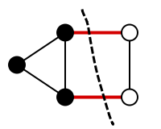
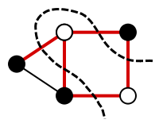
Cut vertex, cut set, cut edge
A cut vertex (or articulation point ) is a vertex, by removing
The one which can partition the graph. A cut edge is an edge by removing the one which can partition the graph. If multiple edges need to be removed to partition the graph, then the minimal set of such edges is a cut set.
Examples taken from Wikipedia

Slide 24

Connectivity in directed graphs
A directed graph is strongly connected if there is a path from
any vertex a to any other vertex b of the graph.
A directed graph is weakly connected if there is a path between
any two vertices of the underlying undirected graph.
Strongly or weakly connected ?

Slide 25
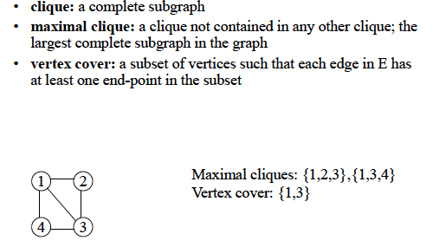
More definitions
Vertex cover is a famous problem in graph theory

Slide 26

Vertex Cover
A vertex-cover of an undirected graph G=(V,E) is a subset V’ of V such that
if edge (u, v) is an edge of G, then u is in V’, or v is in V’, or both. The set
V′ is said to "cover" the edges of G
Minimal or minimum vertex cover is a famous problem in graph theory

Slide 27
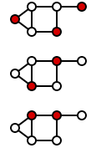
Dominating Set
A dominating set for a graph G = (V, E) is a subset D of V such that
every vertex not in D is adjacent to at least one member of D.
(from Wikipedia)
Computing a minimal or minimum dominating set is a famous problem in graph theory

Slide 28
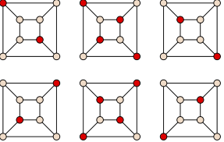
Independent Set
Given a graph G = (V, E) an independent set is a subset of vertices
no two of which are adjacent to one another.
(from Wikipedia)
Computing the maximal independent set is a well-known problem in graph theory

Slide 29
Euler path vs. Hamiltonian path
Hamiltonian path = A path that passes through every vertex
exactly once. A closed path is a Hamiltonian circuit or cycle.
Euler path = A path that includes every edge exactly once.
A closed path is a Euler circuit or cycle.
We have reviewed Euler path in the 7-bridges of Konigsberg
Problem.

Slide 30
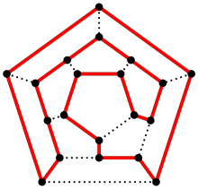
Hamiltonian path
1
2
5
4
3
Does the above graph have
a Hamiltonian cycle? No!
Hamiltonian circuit/cycle
colored red

Slide 31
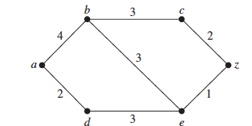
Shortest path
Weighted graph. Compute the shortest path from a to z

Slide 32
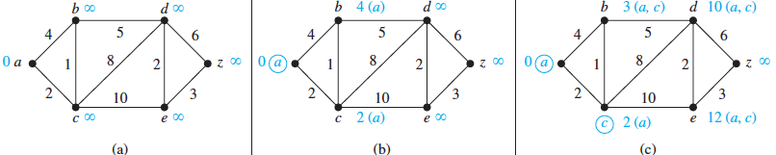
Shortest path: Dijkstra’s algorithm

Slide 33
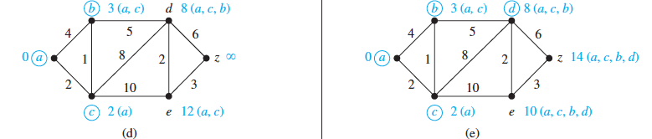
Shortest path: Dijkstra’s algorithm

Slide 34
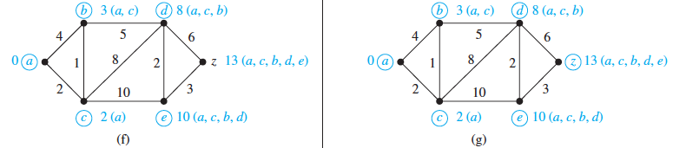
Shortest path: Dijkstra’s algorithm

Slide 35
Shortest path: Dijkstra’s algorithm
Computes the shortest path from a source node to each target node
L (source) = 0, and for all other node u, L(u) := infinity, S:= null
while z is not in S
u := a vertex not in S with L(u) minimal;
S := S ∪ {u};
for all vertices v not in S
if L(u) + w(u, v) < L(v) then L(v) := L(u) + w(u, v)
{known as relaxation: this adds a vertex with minimal label to S and updates the labels of vertices not in S}
return L(z)

Slide 36
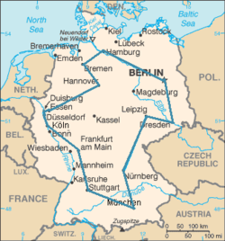
Traveling Salesman Problem (TSP)
A traveling salesman wants to visit each of n cities exactly once, and then return to the starting point. In which order should he
visit the cities to travel the minimum total distance?
TSP = Computing the minimum cost Hamiltonian circuit. TSP is an extremely hard problem to solve (NP-complete)
An optimal TSP tour through
Germany’s largest cities
(Source: Wikipedia)

Slide 37
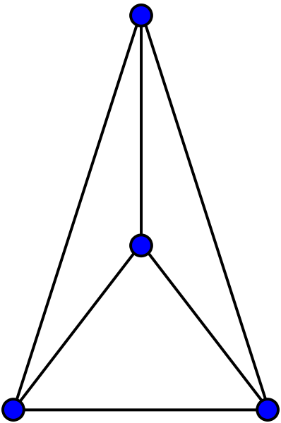
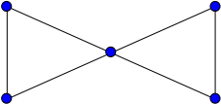
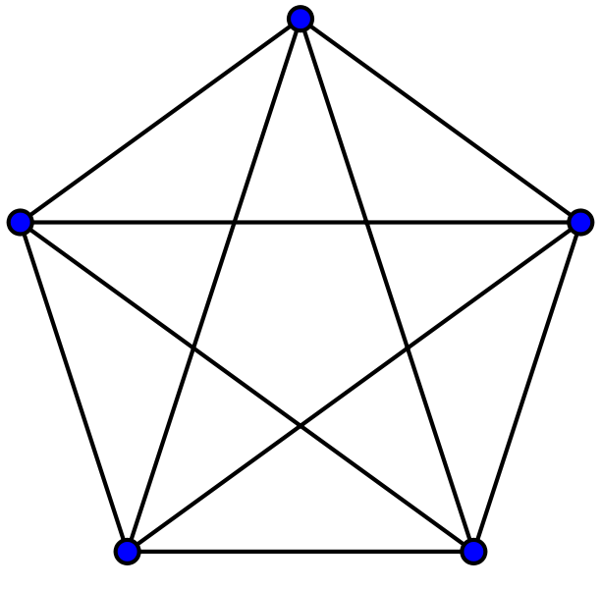

Planar Graph
A planar graph is one that can be embedded in the plane, i.e.,
it can be drawn on the plane in such a way that its edges do
not intersect except only at their endpoints.
planar
K₄
Butterfly
planar
Non-planar
Non-planar
K₅
K_{3,3}

Slide 38
Planar Graph
How to verify that a graph is a planar graph? It should not depend
upon how you draw the graph.
Any graph that contains a K₅ or K_{3,3} as its sub-graph is not planar

Slide 39
Graph Coloring
Let G be a graph, and C be a set of colors. Graph coloring finds an assignment of colors to the different nodes of G, so that no two adjacent nodes have the same color.
The problem becomes challenging when the |C| is small.
Chromatic number. The smallest number of colors needs to color a graph is called its chromatic number.

Slide 40
Graph Coloring
The chromatic number of a tree is 2.

Slide 41
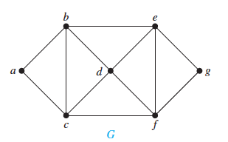
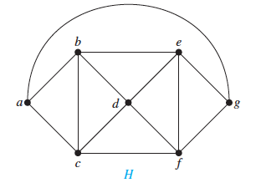
Graph Coloring
What are the chromatic numbers of these two graphs?

Slide 42
Four color theorem
Theorem. Any planar graph can be colored using
at most four colors.
It all started with map coloring – bordering states or counties
must be colored with different colors. In 1852, an ex-student
of De Morgan, Francis Guthrie, noticed that the counties in
England could be colored using four colors so that no adjacent
counties were assigned the same color. On this evidence, he
conjectured the four-color theorem. It took nearly 124 years
to find a proof. It was presented by Andrew Appel and
Wolfgang Haken.

Slide 43
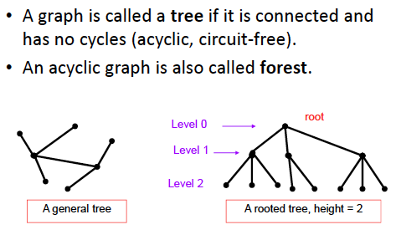
What is a tree?

Slide 44
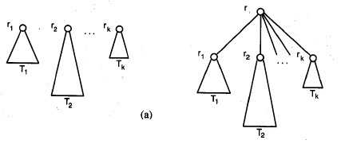
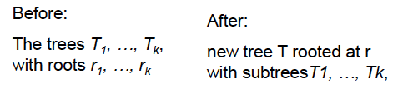
Rooted tree: recursive definition

Slide 45
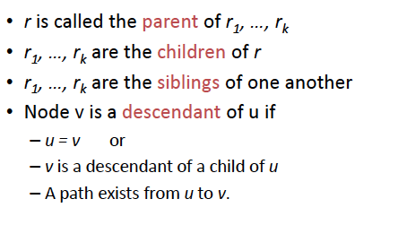
Rooted tree terminology
(If u = v then it is not a “proper” descendant)
If v is a descendant of u, then u is an ancestor of v

Slide 46
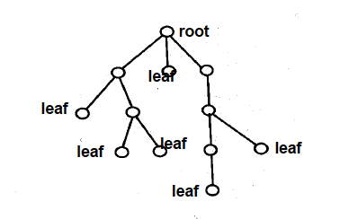
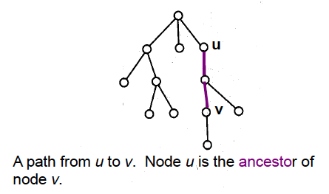
Rooted tree terminology
A subtree

Slide 47
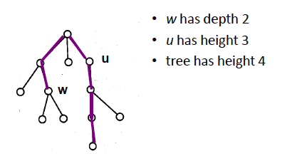
Rooted tree terminology

Slide 48
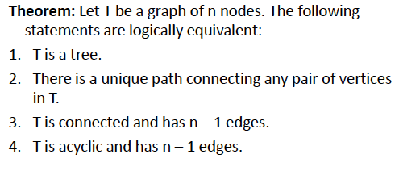
Important properties of trees

Slide 49
Important properties of trees
Theorem. A tree with n nodes has (n-1) edges
Proof. Try a proof by induction

Slide 50
Important properties of trees
Theorem. A tree with n nodes has (n-1) edges
Proof. Try a proof by induction

Slide 51
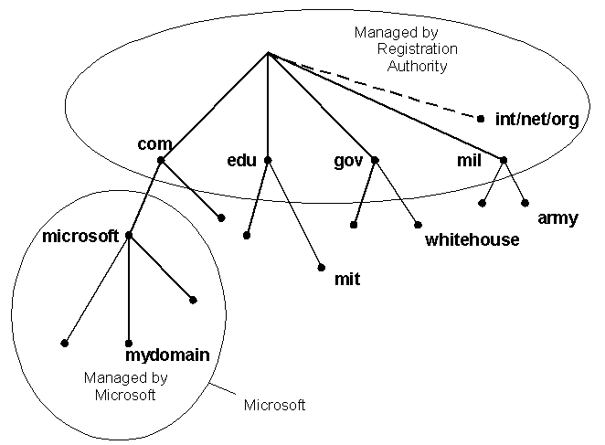
Trees as models
Domain Name System

Slide 52
Trees as models
directory
subdirectory
subdirectory
subdirectory
file
file
file
file
file
file
file
file
file
Computer File System
This tree is a ternary (3-ary) tree, since each non-leaf node has three children

Slide 53
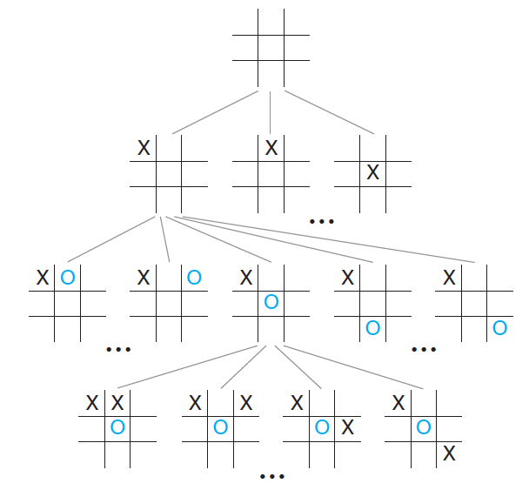
Trees as models: game tree

Slide 54
Binary and m-ary tree
Binary tree. Each non-leaf node has up to 2 children. If every non-leaf
node has exactly two nodes, then it becomes a full binary tree.
m-ary tree. Each non-leaf node has up to m children. If every non-leaf
node has exactly m nodes, then it becomes a full m-ary tree

Slide 55
Properties of trees
Theorem. A full m-ary tree with k internal vertices contains
n = (m.k + 1) vertices.
Proof. Try to prove it by induction.
[Note. Every node except the leaves is an internal vertex]

Slide 56
Properties of trees
Theorem. Every tree is a bipartite graph.
Theorem. Every tree is a planar graph.

Slide 57
Balanced trees
The level of a vertex v in a rooted tree is the length of the unique
path from the root to this vertex. The level of the root is zero. The
height of a rooted tree is the maximum of the levels of vertices.
The height of a rooted tree is the length of the longest path from
the root to any vertex.
A rooted m-ary tree of height h is balanced if all leaves are at
levels h or h − 1.

Slide 58
Balanced trees
Theorem. There are at most m^{h} leaves in an m-ary tree of height h.
Proof. Prove it by induction.
Corollary. If an m-ary tree of height h has l leaves, then
If the m-ary tree is full and balanced, then

Slide 59
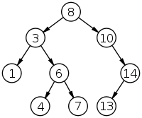
Binary search tree
Ordered binary tree. For any non-leaf node
The left subtree contains the lower keys.
The right subtree contains the higher keys.
How can you search an item? How many steps
does each search take?
A binary search tree of size 9
and depth 3, with root 8 and
leaves 1, 4, 7 and 13

Slide 60
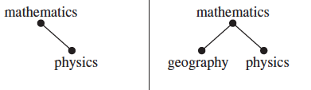
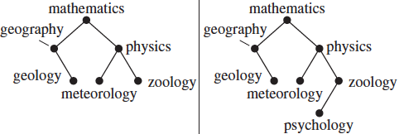
Binary search tree

Slide 61
Insertion in a binary search tree
procedure insertion (T : binary search tree, x: item)
v := root of T {a vertex not present in T has the value null }
while v ≠ null and label(v) ≠ x
if x < label(v) then
if left child of v ≠ null then v := left child of v
else add new vertex as a left child of v and set v := null
else
if right child of v ≠ null then v := right child of v
else add new vertex as a right child of v and set v := null
if root of T = null then add a vertex v to the tree and label it with x
else if v = null or label(v) ≠ x then label new vertex with x and let v be the new vertex
return v {v = location of x}

Slide 62
Decision tree
Decision trees generate solutions via a sequence of decisions.
Example 1. There are seven coins, all of which are of equal weight, and one counterfeit coin that is lighter than the rest. Given a weighing scale, in how many times do you need to weigh (each weighing determines the relative weights of the objects on the the two pans) to identify the counterfeit coin?
{We will solve it in the class}.

Slide 63
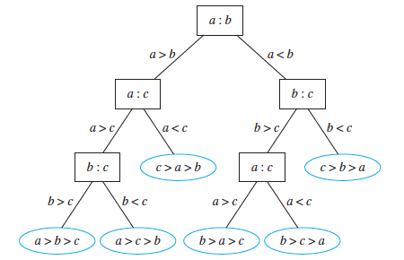
Comparison based sorting algorithms
A decision tree for sorting three elements

Slide 64
Comparison based sorting algorithms
Theorem. Given n items (no two of which are equal), a sorting
algorithm based on binary comparisons requires at least
comparisons
Proof. See page 761-762 of your textbook.
We will discuss it in the class
The complexity of such an algorithm is
Why?

Slide 65
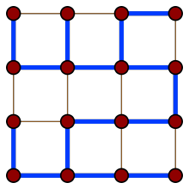
Spanning tree
Consider a connected graph G. A spanning tree is a tree that contains every vertex of G
Many other spanning trees of this graph exist

Slide 66
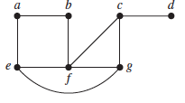
Computing a spanning tree
Given a connected graph G, remove the edges (in some order) without disrupting the connectivity, i.e. not causing a partition of the graph. When no further edges can be removed, a spanning tree is generated.
Graph G

Slide 67


Computing a spanning tree
Spanning tree of G

Slide 68
Depth First Search
procedure DFS (G: connected graph with vertices v1…vn)
T := tree consisting only of the vertex v1
visit(v1) {Recursive procedure}
procedure visit (v: vertex of G)
for each vertex w adjacent to v and not yet in T
add vertex w and edge {v, w} to T
visit (w)
The visited nodes and the edges connecting them form a spanning tree. DFS can also be used as a search or traversal algorithm

Slide 69


Depth First Search: example

Slide 70


Breadth First Search
A different way of
generating a spanning tree
Given graph G
Spanning tree

Slide 71
Breadth First Search
ALGORITHM. Breadth-First Search.
procedure BFS (G: connected graph with vertices v1, v2, …vn)
T := tree consisting only of vertex v1
L := empty list
put v1 in the list L of unprocessed vertices
while L is not empty
remove the first vertex v from L
for each neighbor w of v
if w is not in L and not in T then
add w to the end of the list L
add w and edge {v, w} to T

Slide 72
Minimum spanning tree
A minimum spanning tree (MST) of a connected weighted graph is a spanning tree for which the sum of the edge weights is the minimum.
How can you compute the MST of a graph G?

Slide 73
Huffman coding
Consider the problem of coding the letters of the English
alphabet using bit-strings. One easy solution is to use
5 bits for each letter (2⁵ > 26). Another such example is
The ASCII code. These are static codes, and do not make
use of the frequency of usage of the letters to reduce the
size of the bit string.
One method of reducing the size of the bit pattern is to use
prefix codes.

Slide 74
Prefix codes
In typical English texts, e is most frequent, followed by, l, n, s, t … The prefix tree assigns to each letter of the alphabet a code whose length depends on the frequency:
e = 0, a = 10, l= 110, n = 1110 etc
Such techniques are popular for
data compression purposes. The
resulting code is a variable-length
code.
0
1
e
0
1
a
0
1
l
0
1
n
1
0
s
t

Slide 75
Huffman codes
Another data compression technique first developed
By David Huffman when he was a graduate student
at MIT in 1951. (see pp. 763-764 of the textbook)
Huffman coding is a fundamental algorithm in data
compression, the subject devoted to reducing the number
of bits required to represent information.

Slide 76
Huffman codes
Example. Use Huffman coding to encode the following
symbols with the frequencies listed:
A: 0.08, B: 0.10, C: 0.12, D: 0.15, E: 0.20, F: 0.35.
What is the average number of bits used to encode a
character?

Slide 77

Huffman coding example

Slide 78

Huffman coding example

Slide 79

Huffman coding example

Slide 80
Huffman coding example
So, in this example, what is the average number of bits needed
to encode each letter?
3x 0.08 + 3 x 0.10 + 3 x 0.12 + 3 x 0.15 + 2 x 0.20 + 2 x 0.35 = 2.45
instead of 3-bits per letter.

